Slide 1

“Multi Modal Fashion Trend Analysis using Ensemble Model”
School of Computer Science and Engineering
Department of Computer Science and Engineering
Submitted By: Kayan Patel
23FE10CSE00149
Supervised By: Dr. Praneet Saurabh

Slide 2
Outline
Introduction
Literature Review
Problem Statement
Proposed Solution
Objectives
Results

Slide 3

Introduction
Fashion trend prediction plays a crucial role in the apparel industry for making data-driven decisions.
With the growth of e-commerce and social media, large volumes of data are generated in the form of images, customer reviews, and purchase history.
Traditional approaches rely on manual analysis or single-source data, which limits prediction accuracy.
Fashion trends are influenced by multiple factors such as visual appearance, customer sentiment, and temporal patterns.
Therefore, there is a need for an intelligent system that can analyze multiple data sources simultaneously.

Slide 4
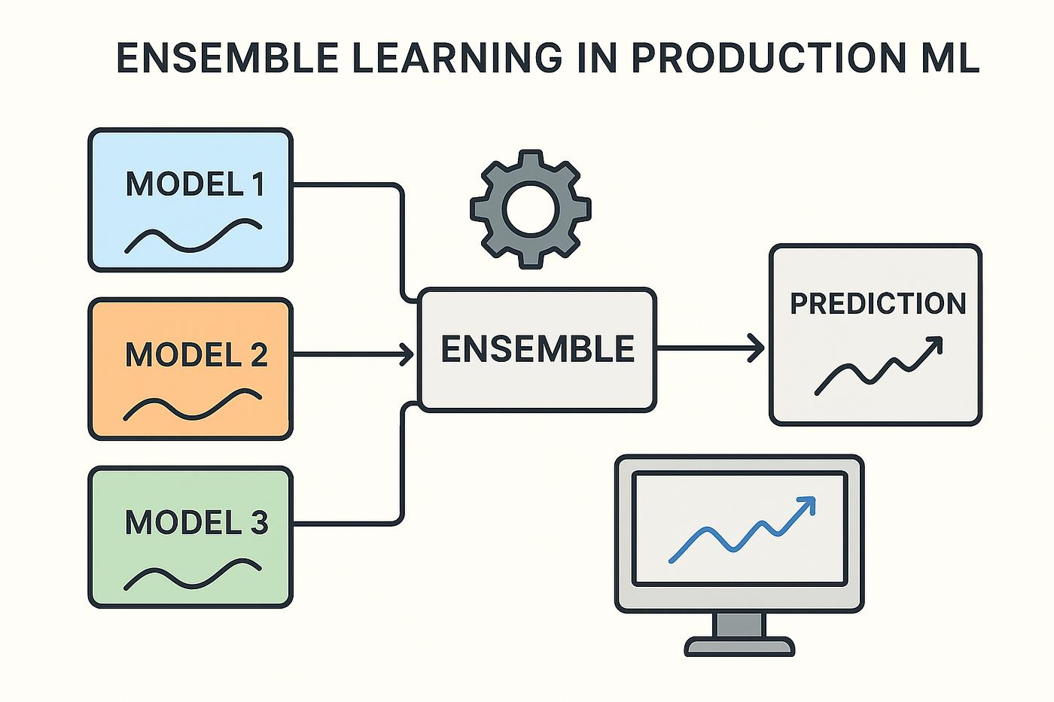
Approach
This work proposes a multi-modal approach for fashion trend prediction.
The system integrates three types of data:
Image Data → CNN (visual features)
Text Data → Sentiment Analysis (customer opinions)
Time-Series Data → LSTM (trend patterns over time)
These models are combined using an ensemble technique to improve prediction accuracy.
The approach captures multiple dimensions of fashion trends, leading to better and more reliable predictions.

Slide 5
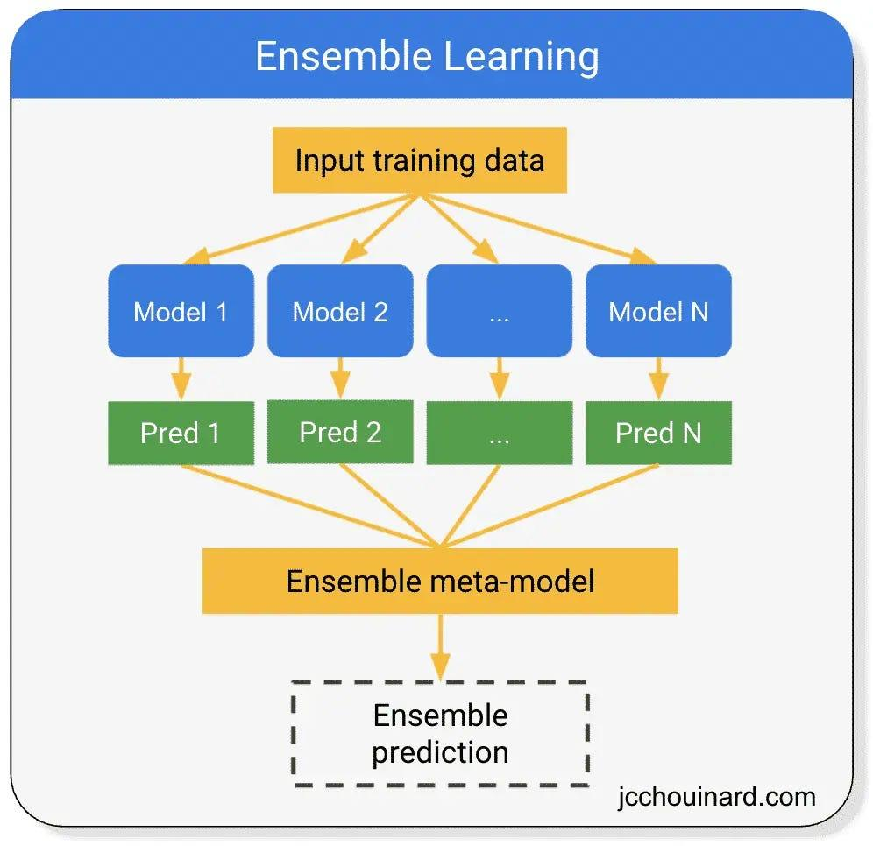
Literature Review
Fashion trend prediction has been widely studied using machine learning and deep learning techniques.
CNN models are used for extracting visual features from fashion images.
NLP techniques such as TF-IDF and Logistic Regression are used for sentiment analysis of customer reviews.
LSTM models are applied to capture temporal patterns in time-series data.
Ensemble learning combines multiple models to improve prediction accuracy.

Slide 6
Most existing approaches focus on single data modality:
Only image-based
Only text-based
Only time-series
These methods fail to capture the multi-dimensional nature of fashion trends.
Limited work has been done in integrating:
Visual data
Textual data
Temporal data
This creates a research gap in developing a unified system.
Hence, a multi-modal ensemble approach is required for better prediction accuracy.

Slide 7

Problem Statement
Existing fashion trend prediction methods rely on single-source data such as images or textual reviews, leading to limited accuracy. These approaches fail to capture the combined influence of visual features, customer sentiment, and temporal patterns. Therefore, there is a need for a unified multi-modal system to improve prediction accuracy and reliability.

Slide 8
Objectives
To develop a multi-modal system for fashion trend prediction using image, text, and time-series data.
To implement CNN, sentiment analysis, and LSTM models for extracting visual, textual, and temporal features.
To combine the outputs of multiple models using an ensemble approach for improved accuracy.
To evaluate and compare model performance using metrics such as accuracy, precision, recall, and F1-score.

Slide 9
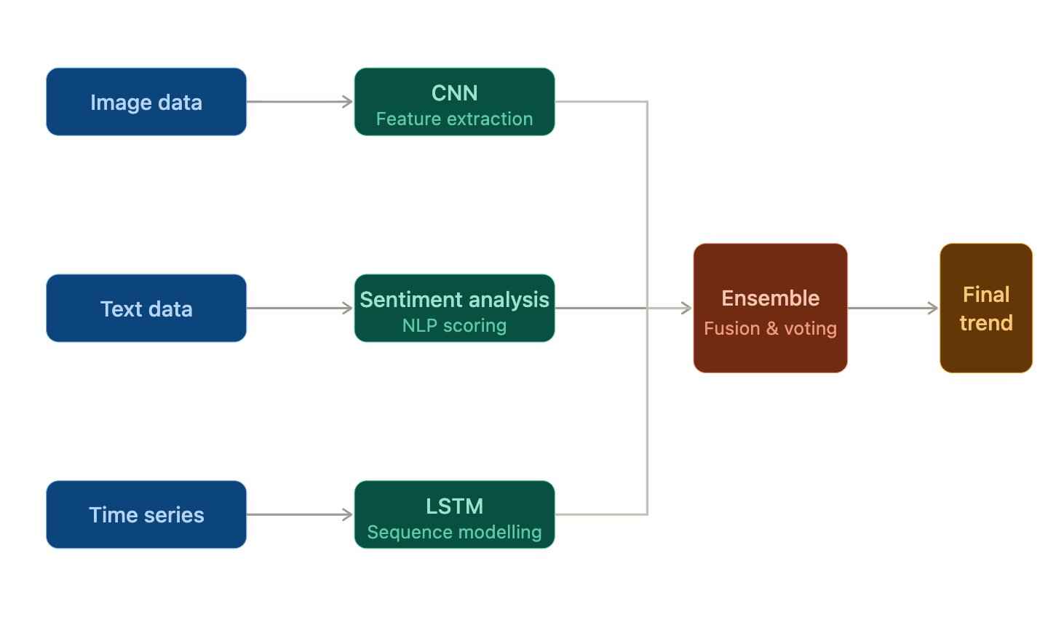
Proposed Methodology
The proposed system follows a multi-modal approach for fashion trend prediction.
It integrates three types of data:
Image data
Text data
Time-series data
Each data type is processed using a specialized model.
The outputs are combined using an ensemble technique to generate the final trend prediction.

Slide 10
DATA PROCESSING & MODELS
Image Data → CNN
Extracts visual features (style, texture, color)
First, the input image is passed through convolution layers where filters extract patterns like edges and textures. Then activation and pooling refine these features. Finally, the features are flattened and used for prediction.
Text Data → Sentiment Analysis
Uses TF-IDF + Logistic Regression
Captures customer opinions
First, the text is cleaned and pre-processed. Then TF-IDF converts it into numerical form. Finally, Logistic Regression classifies the sentiment as positive or negative.
Time-Series Data → LSTM
Learns temporal patterns
Predicts future trends
First, time-series data is pre-processed and converted into sequences. Then LSTM learns temporal patterns from past data and predicts future trends.

Slide 11
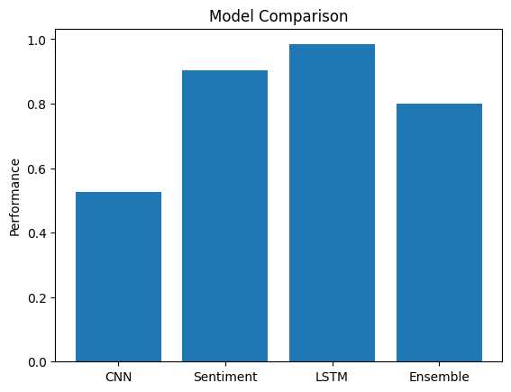
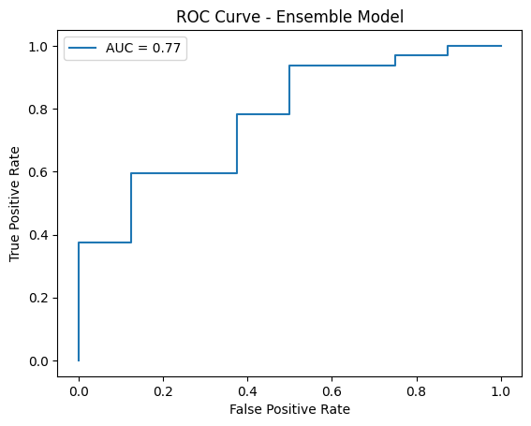
ENSEMBLE APPROACH
Outputs from CNN, sentiment analysis, and LSTM are combined.
A weighted averaging (fusion) technique is used.
Each model contributes based on its importance.
Improves:
Accuracy
Reliability
Overall prediction performance

Slide 12
.
SYSTEM ARCHITECTURE
The system processes image, text, and time-series data in parallel.
CNN extracts visual features from images.
Sentiment analysis captures customer opinions from text data.
LSTM models temporal patterns from time-series data.
Outputs are combined using an ensemble model to generate the final trend.

Slide 13
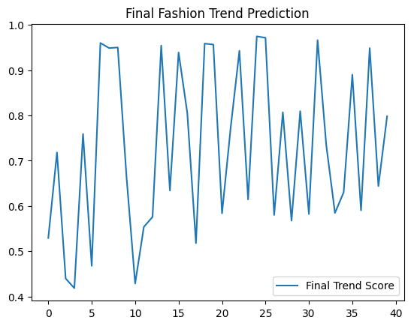
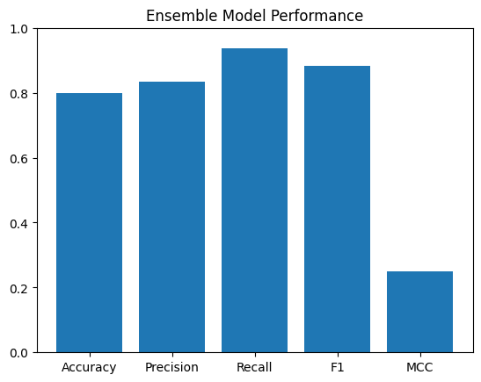
Results
This graph shows the final trend score predicted by the ensemble model.
The values range roughly between 0.4 to 1.0, indicating varying trend intensity.
Peaks in the graph represent high trend popularity, while dips indicate lower trend relevance.
The fluctuations show that fashion trends are dynamic and change over time.
Overall, the model successfully captures real-world trend variations. This graph shows the performance metrics of the ensemble model.
Multi-modal Fashion Trend Prediction Framework

Slide 14
Continued…
Model | Accuracy (%) | Precision | Recall | F1 Score | MCC
CNN Model | 53% | 0.54 | 0.53 | 0.52 | 0.56
Sentiment Analysis | 90.26% | 0.93 | 0.96 | 0.94 | 0.68
Ensemble Model | 80% | 0.83 | 0.94 | 0.88 | 0.25
The LSTM model captures time-based patterns and predicts trends. It performs well overall but struggles slightly with sudden spikes.
LSTM is NOT classification → it is regression

Slide 15
Outcome
The proposed research work is currently under development and is in the process of being finalized for publication. Preliminary results indicate promising performance of the multi-modal ensemble approach in fashion trend prediction. The study is being further refined to enhance accuracy and robustness before final submission.

Slide 16
References
[1] A. Krizhevsky, I. Sutskever, and G. E. Hinton, “ImageNet classification with deep convolutional neural networks,” Advances in Neural Information Processing Systems, 2012.
[2] M. Sandler, A. Howard, M. Zhu, A. Zhmoginov, and L. Chen, “MobileNetV2: Inverted residuals and linear bottlenecks,” IEEE Conference on Computer Vision and Pattern Recognition (CVPR), 2018
[3] Y. Kim, “Convolutional neural networks for sentence classification,” Proceedings of the 2014 Conference on Empirical Methods in Natural Language Processing, 2014.
[4] J. Ramos, “Using TF-IDF to determine word relevance in document queries,” Proceedings of the First Instructional Conference on Machine Learning, 2003.
[5] D. Jurafsky and J. H. Martin, Speech and Language Processing, Pearson, 2019
[6] S. Hochreiter and J. Schmidhuber, “Long short-term memory,” Neural Computation, vol. 9, no. 8, pp. 1735–1780, 1997.
[7] T. Mikolov et al., “Recurrent neural network based language model,” INTERSPEECH, 2010
[8] L. Breiman, “Bagging predictors,” Machine Learning, vol. 24, no. 2, pp. 123–140, 1996.
[9] T. G. Dietterich, “Ensemble methods in machine learning,” Multiple Classifier Systems, 2000.
[10] B. Liu, Sentiment Analysis and Opinion Mining, Morgan & Claypool Publishers, 2012.
[11] F. Chollet, Deep Learning with Python, Manning Publications, 2018.
[12] K. P. Murphy, Machine Learning: A Probabilistic Perspective, MIT Press, 2012.

Slide 17
Thank You

